Slide 1
WiFi Score Machine Learning - Extender Recommendation
March, 2024
VMAS

Slide 2
Objective
Recommend extenders to customers
Based on potential improvements in their WiFi performance
WiFi performance using a metric termed the “WiFi-score”
The probability of achieving WiFi-score enhancement is deemed as the extender score.
Extend the model as template for other cases, such as churn prediction
Notes:
if there is a high likelihood that a customer will attain a higher WiFi score following the installation of a WiFi extender, we advocate for proceeding with the installation.
Broaden the scope of model, beyond just extender recommendation.

Slide 3
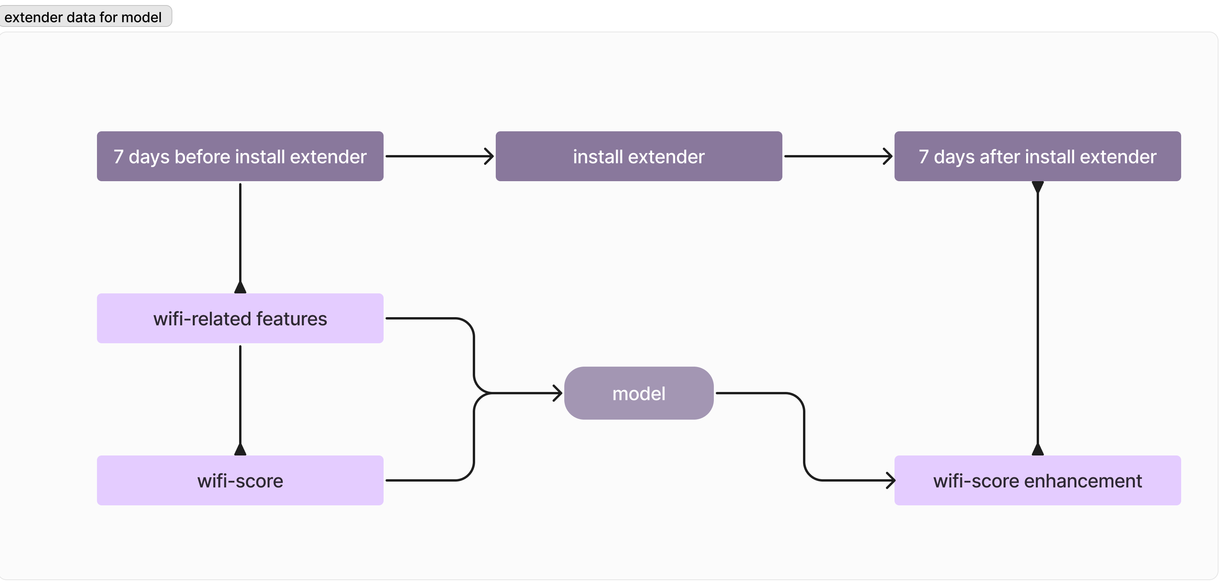
Step 1: Model Development
Notes:
Collect data from homes recently installed extenders, including WiFi KPIs and WiFi-scores (KPIs would be the feature of model, WiFi-Score increment would be the target of model).
This dataset include n-days before and after the installation of extender, allowing for a comprehensive comparison of WiFi performance before and after the intervention.
Use this data to build a predictive model that identifies attributes of families exhibiting significant WiFi performance enhancement after installing extender.

Slide 4
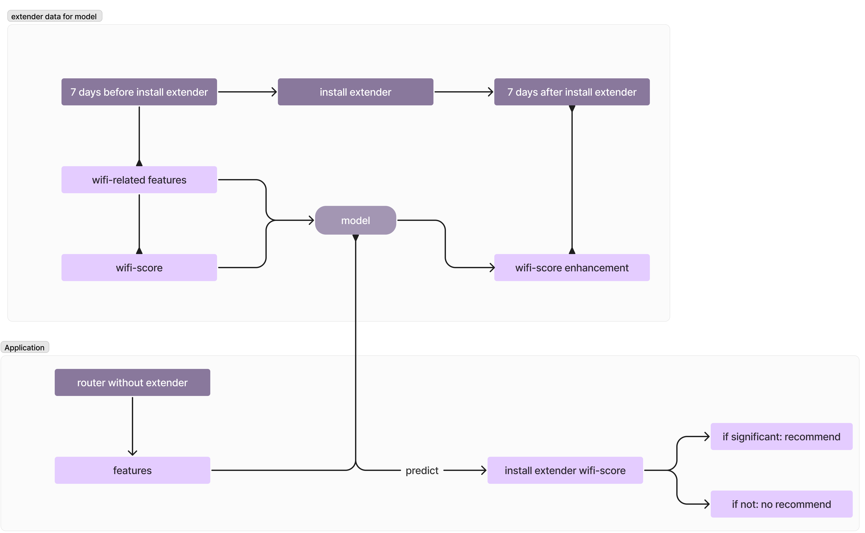
Step 2: Model Application and Recommendation

Slide 5
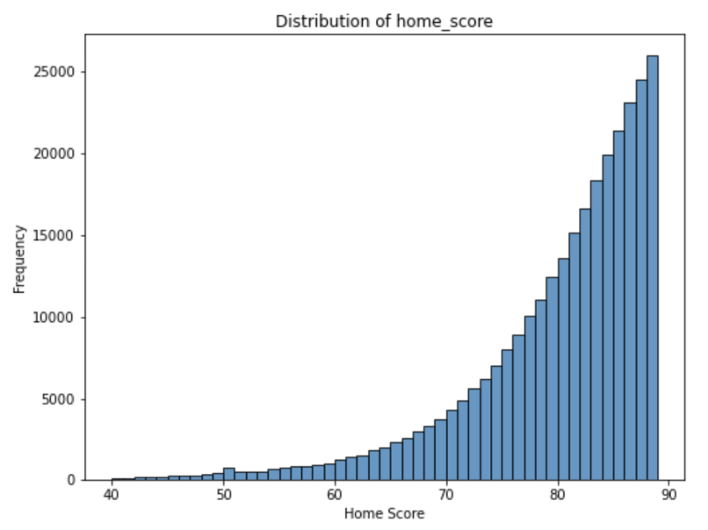
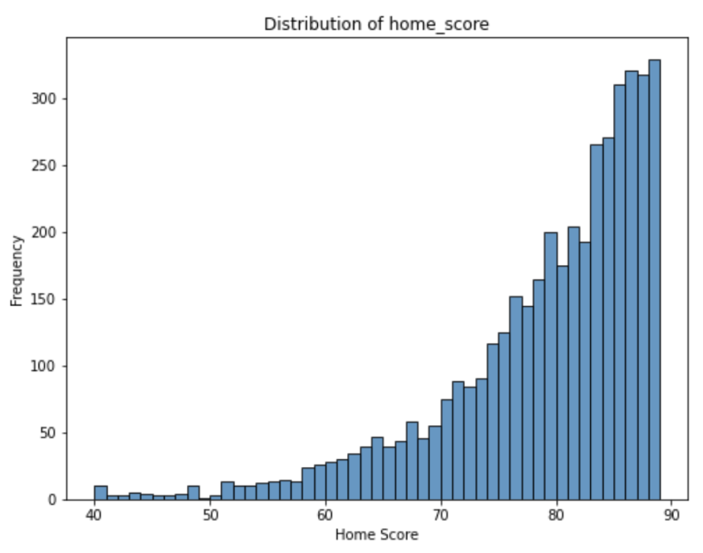
*Assumption
Extender data is randomly sampled from router population
Because the extender model data is representative, we can apply it to all router family
Router home Extender home

Slide 6
Model Description-features
The model aims to predict a binary outcome, score_enhancement(0 or 1)
Predcitors
signal strength categories (avg_sig_strength_cat1, avg_sig_strength_cat2, avg_phyrate), volume, num_station
home score metrics (before_home_score, lowest_n_score)
network performance indicators (poor_phyrate, poor_rssi).
Labels
score_increment feature,
after_home_score > before_home_score as 1
after_home_score <= before_home_score as 0

Slide 7
Model Building
Both two models use RandomForestClassifier, trained with parameters like:
n_estimators=50,
max_depth=5,
min_samples_split=10,
min_samples_leaf=5
class weights adjusted to balance the dataset.
Notes:
The model itself is really simple, since we do not have many features so far.
I will talk more about the evaluation.

Slide 8
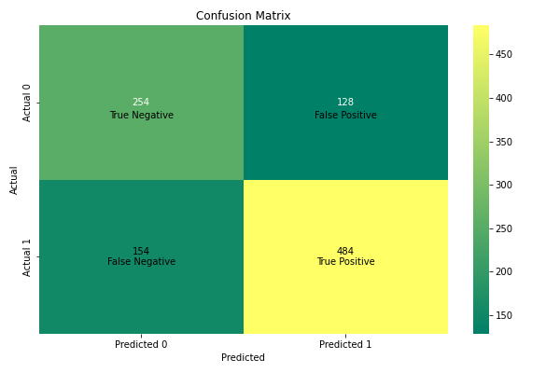
Model Evaluation
Test Accuracy: 0.72
Precision: 0.79
Recall: 0.76

Slide 9
Model Evaluation
Test Accuracy: 0.72
Precision: 0.79
Recall: 0.76
Recall: Profit For class improved , among all actual improved, 0.76 were correctly predicted as improved.
Precision: Reverse Cost For class improved , among all instances predicted as improved, 0.79 were actually improved.

Slide 10
Model Evaluation
Metrics vary with before_home_score
Model performance(Precision/recall)
Precision vs Size
Among [70-75], [75-80], [80-85], [85-90]
before_home_score_increment | precision | recall | true_positive | false_positive | false_negative | true_negative | total_actual_positive | total_actual_negative | total_samples
(50, 55] | 0.833 | 1 | 10 | 2 | 0 | 0 | 10 | 2 | 12
(55, 60] | 0.867 | 1 | 13 | 2 | 0 | 0 | 13 | 2 | 15
(60, 65] | 0.875 | 1 | 14 | 2 | 0 | 0 | 14 | 2 | 16
(65, 70] | 0.778 | 0.903 | 28 | 8 | 3 | 0 | 31 | 8 | 39
(70, 75] | 0.815 | 1 | 44 | 10 | 0 | 7 | 44 | 17 | 61
(75, 80] | 0.906 | 0.989 | 87 | 9 | 1 | 10 | 88 | 19 | 107
(80, 85] | 0.802 | 0.967 | 89 | 22 | 3 | 18 | 92 | 40 | 132
(85, 90] | 0.764 | 0.947 | 126 | 39 | 7 | 2 | 133 | 41 | 174
(90, 95] | 0.579 | 0.407 | 44 | 32 | 64 | 56 | 108 | 88 | 196
(95, 100] | 0.8 | 0.05 | 4 | 1 | 76 | 160 | 80 | 161 | 241

Slide 11
Model Evaluation- [90-95], [95-100]
High-Score home benefit less from extender
Model limitation:
WiFi score, family-wide WiFi performance, neglecting individual device effects.
Limited features not accurately identify benefit households
before_home_score_increment | precision | recall | true_positive | false_positive | false_negative | true_negative | total_actual_positive | total_actual_negative | total_samples
(50, 55] | 0.833 | 1 | 10 | 2 | 0 | 0 | 10 | 2 | 12
(55, 60] | 0.867 | 1 | 13 | 2 | 0 | 0 | 13 | 2 | 15
(60, 65] | 0.875 | 1 | 14 | 2 | 0 | 0 | 14 | 2 | 16
(65, 70] | 0.778 | 0.903 | 28 | 8 | 3 | 0 | 31 | 8 | 39
(70, 75] | 0.815 | 1 | 44 | 10 | 0 | 7 | 44 | 17 | 61
(75, 80] | 0.906 | 0.989 | 87 | 9 | 1 | 10 | 88 | 19 | 107
(80, 85] | 0.802 | 0.967 | 89 | 22 | 3 | 18 | 92 | 40 | 132
(85, 90] | 0.764 | 0.947 | 126 | 39 | 7 | 2 | 133 | 41 | 174
(90, 95] | 0.579 | 0.407 | 44 | 32 | 64 | 56 | 108 | 88 | 196
(95, 100] | 0.8 | 0.05 | 4 | 1 | 76 | 160 | 80 | 161 | 241
Notes:
The WiFi score serves as a generalized estimation of the entire family's WiFi performance, rather than individual devices. Consequently, when predicting extender recommendations, we can only capture the overall effect of the extender installation, lacking the ability to discern the impact on individual devices.
Furthermore, our dataset is constrained by limited features. Consequently, for households that exhibit improved WiFi scores following extender installation, we may lack sufficient information to accurately identify them or differentiate them from households that do not experience improvement.
Low score, typically benefit significantly from install extender, even with limited model, we still be able to capture it.

Slide 12
Objective
Recommend extenders to customers
Based on potential improvements in their WiFi performance
WiFi performance using a metric termed the “WiFi-score”
The probability of achieving WiFi-score enhancement is deemed as the extender score.
Notes:
if there is a high likelihood that a customer will attain a higher WiFi score following the installation of a WiFi extender, we advocate for proceeding with the installation.

Slide 13
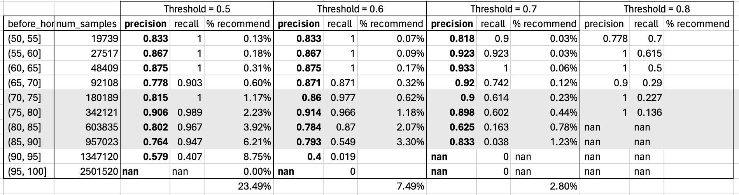
Threshold

Slide 14
Conclusion
Focus on Precision
Effective at mid-score range
Limited by small dataset and influenced feature
Limited number of data
Further explored including device_model, other wifi-related features.

Slide 15
Overall Further Work
Adding device model info to normalize the WiFi score
Developing machine learning model based on WiFi score and leveraging with churn data

Slide 16
Extender Model Development
Notes:
Collect data from homes recently installed extenders, including WiFi KPIs and WiFi-scores (KPIs would be the feature of model, WiFi-Score increment would be the target of model).
This dataset include n-days before and after the installation of extender, allowing for a comprehensive comparison of WiFi performance before and after the intervention.
Use this data to build a predictive model that identifies attributes of families exhibiting significant WiFi performance enhancement after installing extender.

Slide 17
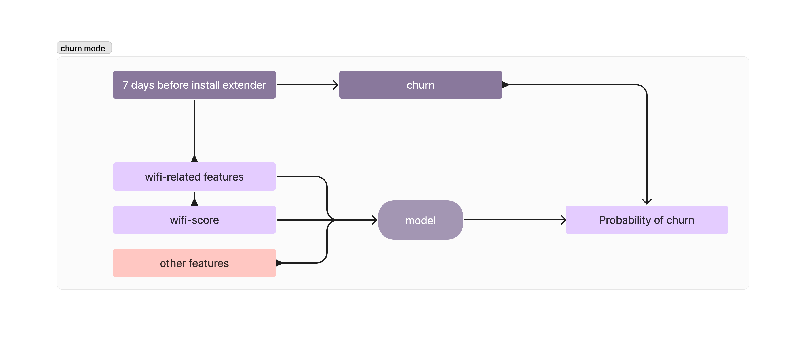
Overall Further Work - Churn Model

Slide 18
Thanks !

Slide 20
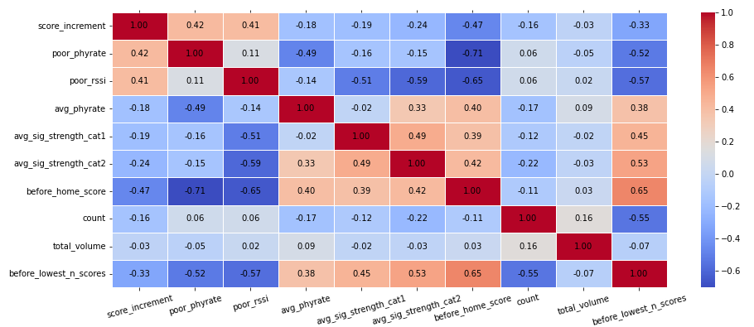
Future work- expand more features

Slide 21
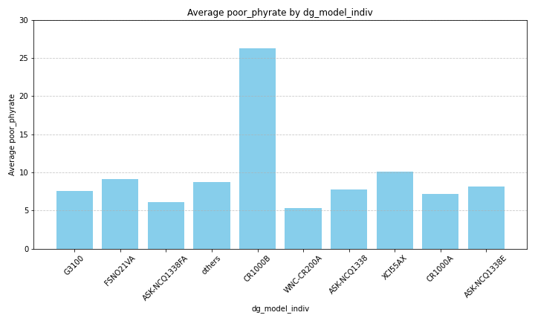
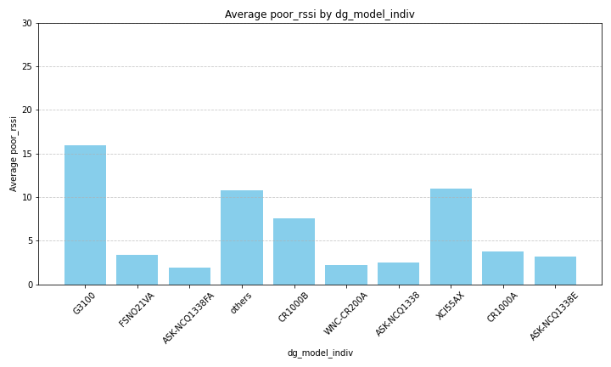
Future work- device_model

Slide 22
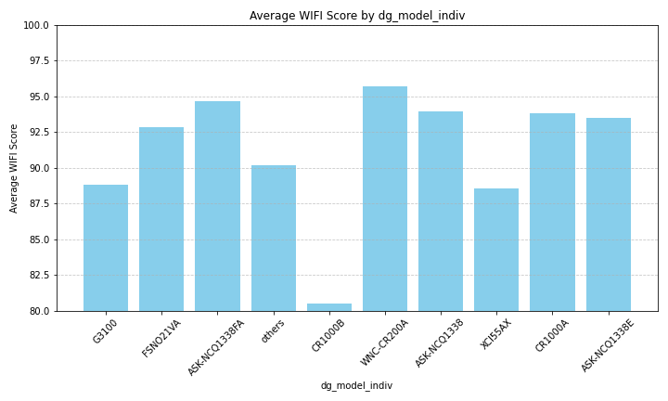
Future work- device_model

Slide 23
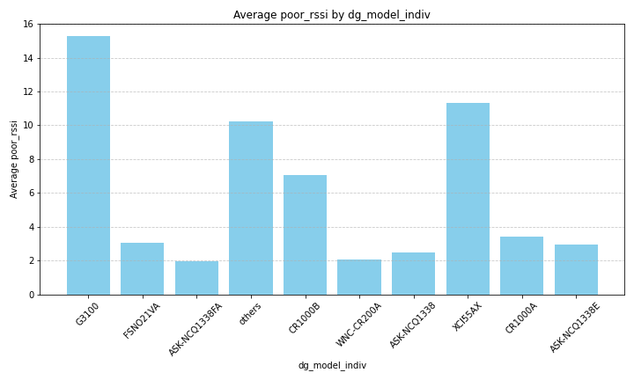
Future work- device_model

Slide 24
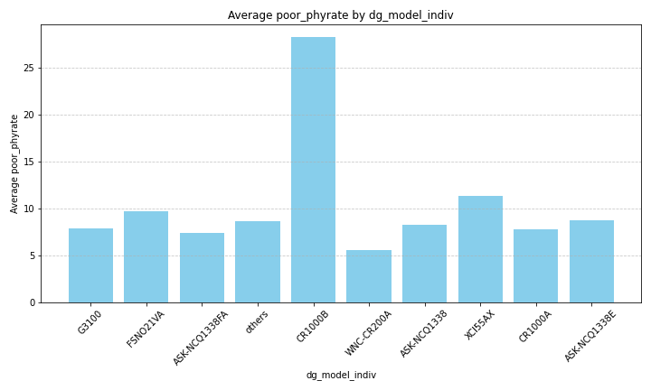
Future work- device_model

Slide 25
